Slide 1




Unreal Expectations
February 8th standup

Slide 2
timeline
2/1
2/8
2/15
FINAL
I am here
Combat
Unit HP
Unit Death
How about a map that is not a grey tetrahedron with a grid on it?
‘Turning’
Endgame
Finish GUI
Maybe smooth camera transition
Bug Fixes
Tweaks
Improvements
Stretch Goals

Slide 3
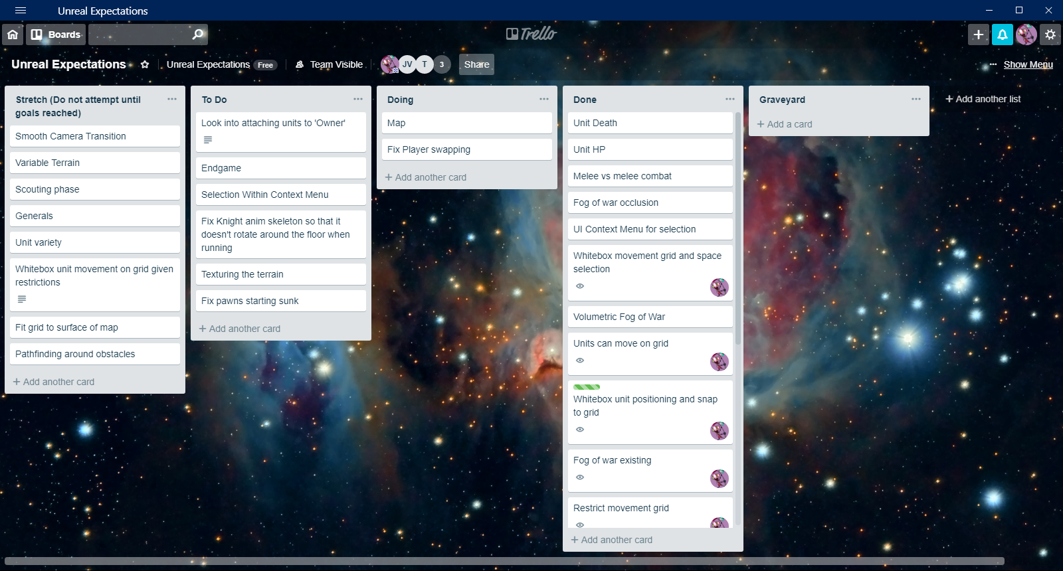
TRell

Slide 4
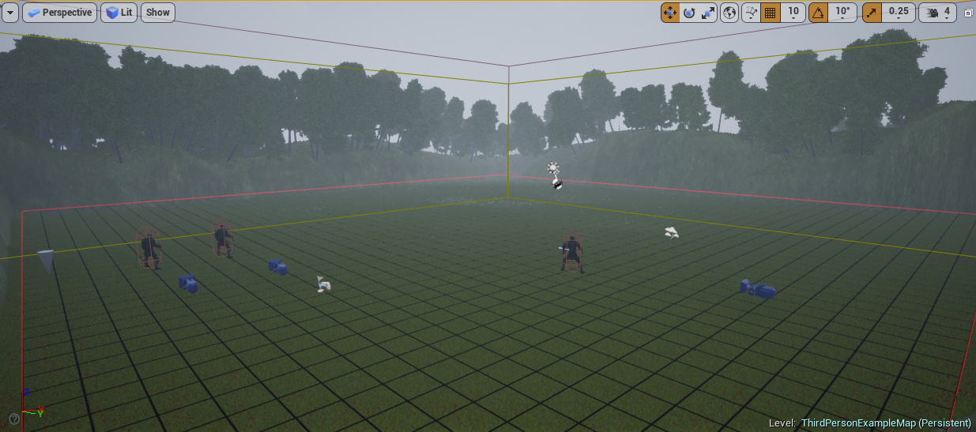
MAP

Slide 5
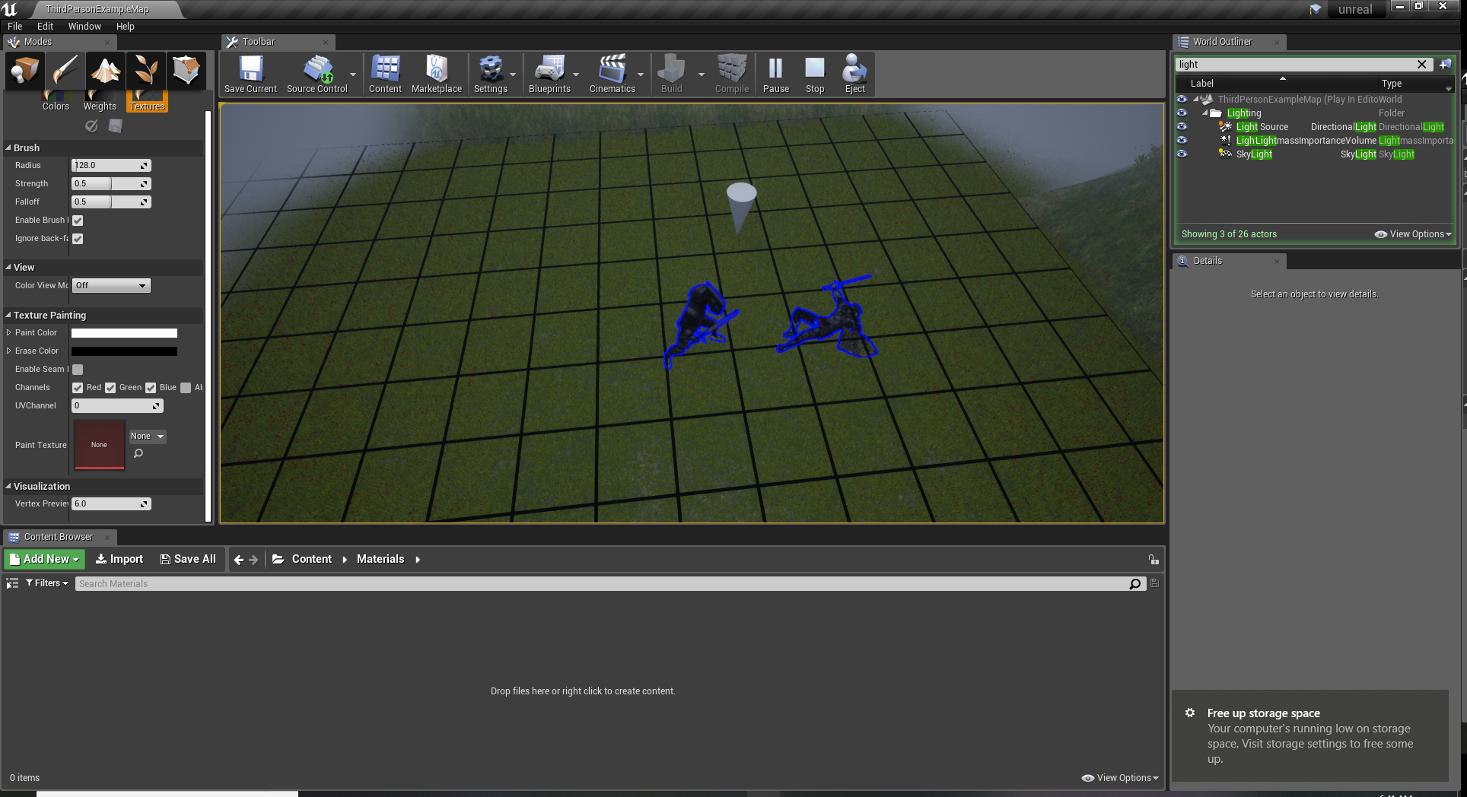
Unit Combat, HP, and Death

